Slide 1

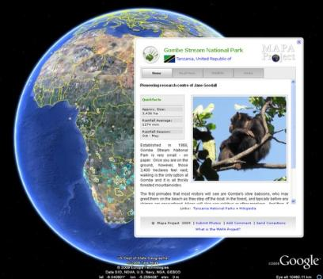
THE MAPA PR JECT:
DIGITIZING CONSERVATION AREAS AND ACTIONS IN AFRICA
March Turnbull and Alta De Vos*
alta@mapaproject.org

Slide 2
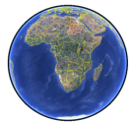





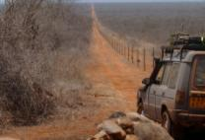
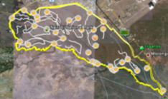
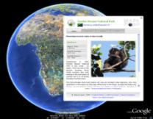
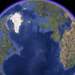
MAPA in a minute
Mapping Africa’s Protected Areas
Points, lines and Polygons
Mapping Africa’s Conservation Landscape
Google Earth as a platform to tell the story of protected areas
Notes:
The MAPA project orginated as an initiative to map all African Protected areas (IUCN category I,II, IV), in partnership with Google Earth. This relationship led us to choose Google Earth as a platform for telling the story of these protected areas, and with a lot of help from the Google Earth Outreach team, we created a public layer that aims to, in a very populist way, tell the story of the African conservation landscape.

Slide 3
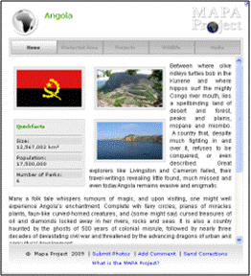
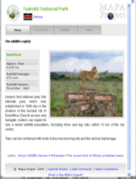

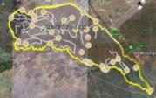
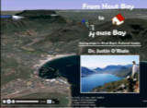
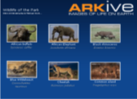
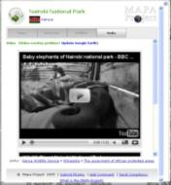
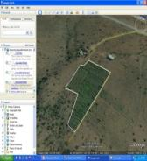
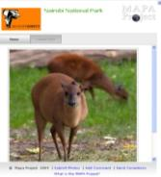
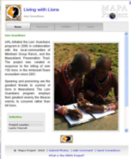
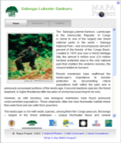
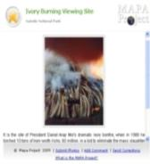
The Conservation Landscape
Roads & boundaries
Other Google Earth-
Wildlife
COUNTRIES
PROTECTED AREAS
Videos & articles
And GIS Content
Blogs
PROJECTS
CRITICAL
HABITATS
POINTS
Notes:
The conservation landscape on the MAPA layer consist of 5 bubble types: Countries, which links to Protected Areas, Critical habitats (such as important bird areas or key biodiversity areas), conservation projects and points. Each of these bubbles is essentially a little webpage that opens when you click on a point on the map. The information contained on these web pages consist of text, points, lines and polygons, embedded video and articles, other gis- and google earth content, blogs, and wildlife, with numerous links to more detailed information and specialist webpages.

Slide 4

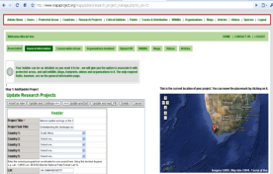

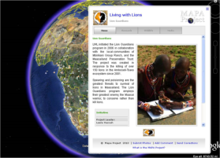
MAPA’s Mechanics
Conservationists
NGOs
Managers
Information input
Online Database
Information output
Public
Google Earth layer
Notes:
The way the layer works is that we have a central web-based database that anyone with access can enter information into. This feeds the layer, which is then made available to the public. At the moment, most of the information is entered by MAPA, but our target is to have the entire database and layer authored by the conservation community. A very ambitious target, we realize, but one that is critical if the project is to succeed sustainably.

Slide 5

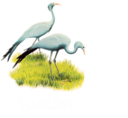
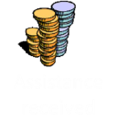
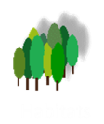

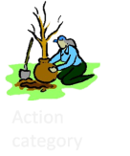
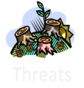
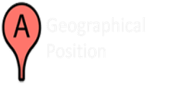
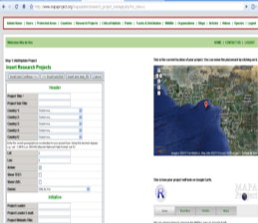


Categorizing Conservation
Following Kapos et al. 2008; Salafsky et al. 2008, Conservation Registry (www.conservationregistry.org)
PROJECTS
Outcomes and Successes
Notes:
Although it is challenging to get the entire conservation community on board, should we succeed the resource available will not only be a layer for the project but an information portal for conservationists….so in optimistic positive anticipation of success and in a “build-it-and-they-will-come-attitude, we’re in the process of changing the input screens in the database to include information that will see projects categorized according to a number of standardized criteria.

Slide 6

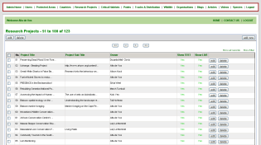

PUBLIC INFORMATION PORTALS
Search on categories and keywords
LISTED RESULTS
More Detailed information on Website, including:
Contact Person and details
Project documents (including publications)
Data
More links
Generate Google Earth File to view search result on Google Earth
Notes:
Which will facilitate an easy way for anyone wanting to find information on conservation projects addressing particular threats, working in particular habitats or on particular species etc. to find the people and places doing this work, along with more detailed documentation. Not neglecting the public face of the project, any search query can also be turned into a Google Earth file. This file can be saved and embedded in 3rd party websites at will. So in this way organizations can create their own Google Earth layer without having to hire the technical expertees to do it.

Slide 7
POINTS TO PONDER
What will it take to get the conservation community involved on this scale?
How can we develop the project to better suit conservationists’ needs?
Can we make sure that the underlying data can be used to identify gaps and measure conservation trends in Africa?
Notes:
So that – in very short- is what the project is and where it is going. My questions to you are: What will it take to get the conservation community involved on this scale? Are we on the right track – how can we develop the project to better suit conservationists’ needs? And lastly – we’ll have a database with categorized information…how can we make sure that the underlying data can be used to identify gaps and measure conservation trends in Africa? I’d love to discuss these questions with you after the presentation. Thank you for your attention.

Slide 8
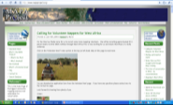
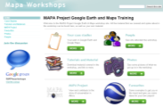
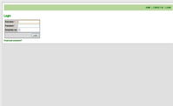
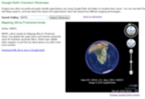
More about MAPA
MAPA Website
www.mapaproject.org
Workshops
https://sites.google.com/site/mapaworkshops
Add your project
http://www.mapaproject.org/mapa
See http://www.mapaproject.org for help material
Download the layer
http://mw1.google.com/mw-earth-vectordb/outreach/mapa/nl_mapa.kml
Or
www.mapaprojec.org

Slide 9

Thank you!
The Mapa Project:
Kath Potgieter
Peter Levey
Erick Ndava
Johann Groenewald
Google & Google Earth Outreach:
Julie Sohn
Sean Askay
Karin Tuxen-Bettman
Tanya Keen
Snowball effect
Andrew Nash
Storm van der Merwe
Lizette Kleynhans
Everyone who has volunteered and contributed to the project thus far!

